Slide 1



AcF 304 Financial Markets Topic 5 – The Foreign Exchange Market
Part 4 – FX Spot Trading
Notes:
If this PowerPoint presentation contains mathematical equations, you may need to check that your computer has the following installed:
1) MathType Plugin
2) Math Player (free versions available)
3) NVDA Reader (free versions available)

Slide 2

Financial Markets and Institutions
Ninth Edition, Global Edition
Parts 4 and 5 are very practical and are not covered in – Chapter 15 The Foreign Exchange Market
Notes:
If this PowerPoint presentation contains mathematical equations, you may need to check that your computer has the following installed:
1) MathType Plugin
2) Math Player (free versions available)
3) NVDA Reader (free versions available)

Slide 3
Why does FX exist?
One counterparty buys one currency for another which is sold by the other counterparty, at a specified date, for a specified rate
Trade and Investment
Hedging
Speculation
Hedging is a risk management strategy employed to offset potential losses in investments, e.g., I might own US stocks but think the market might fall in the short term. I might buy an additional financial instrument that gives good returns if US stocks fall.

Slide 4
Major FX Players
Commercial Banks
Investment Banks
Central Banks
Corporate Treasurers
Hedge Funds
Thomson Reuters/Refinitive
EBS/ICAP
Investment Banks Portals

Slide 5
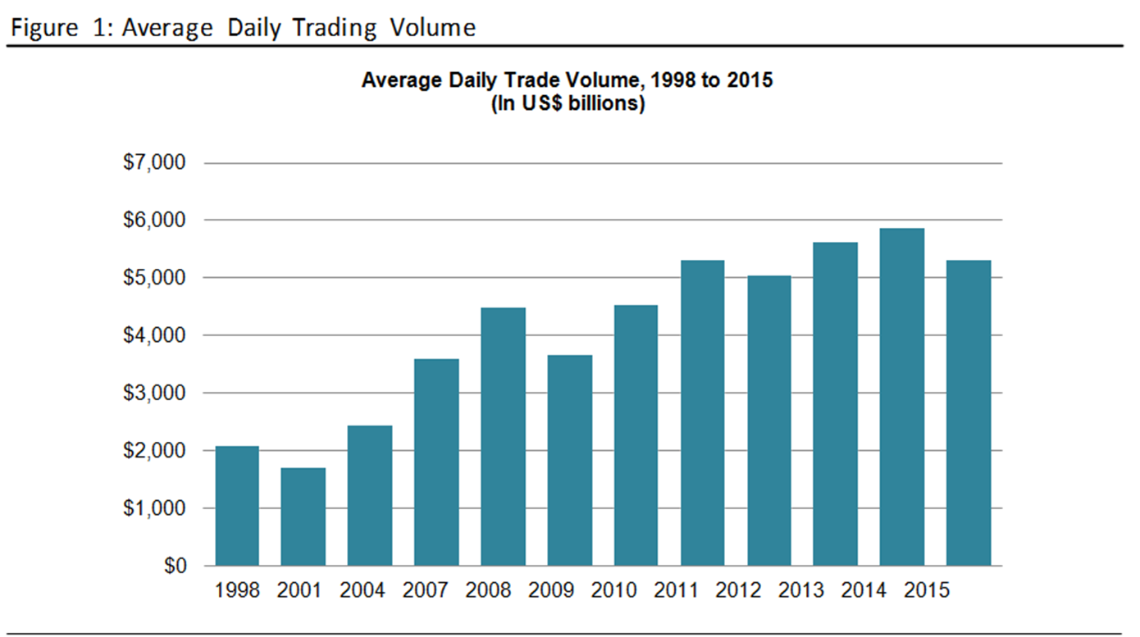

Slide 6
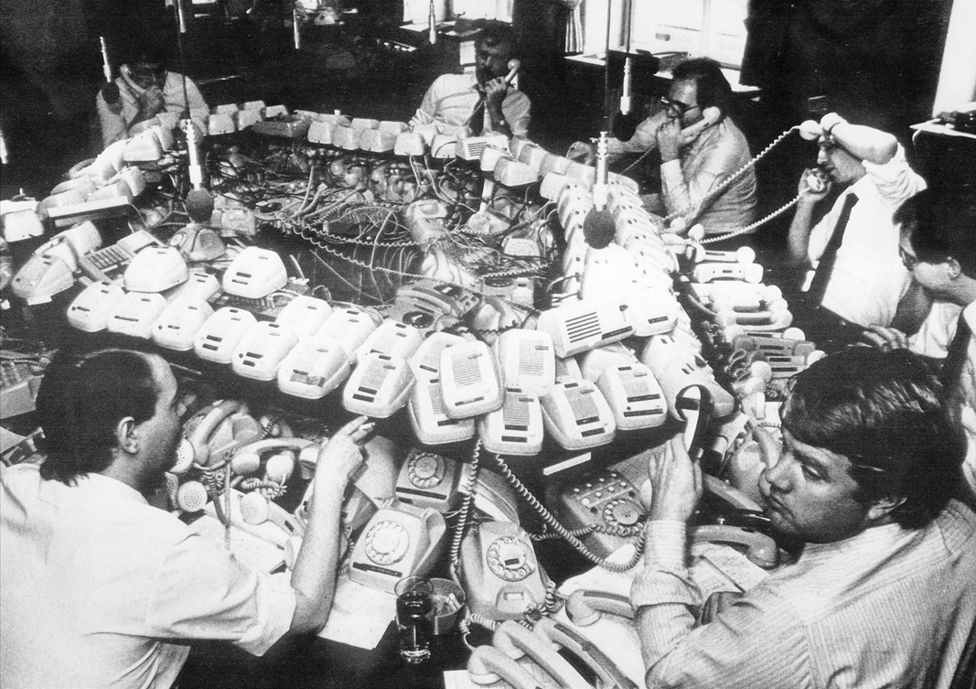
Before…

Slide 7
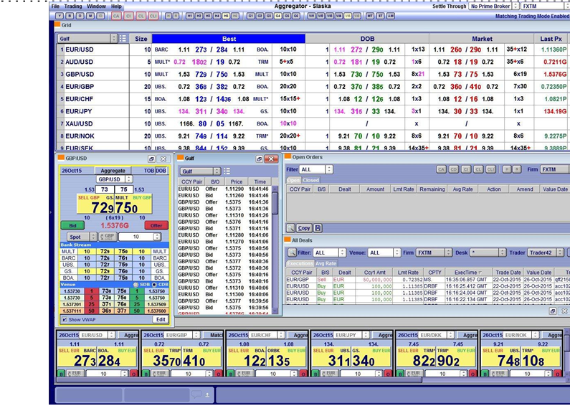
After…

Slide 8
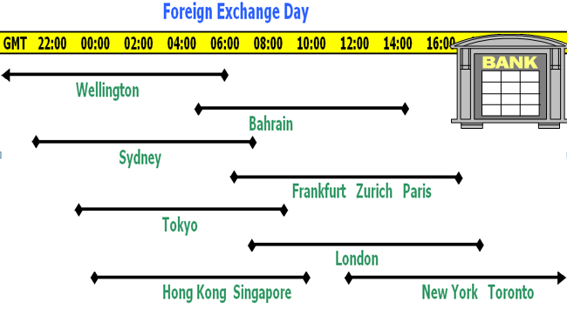
OTC - Over The Counter Banks and Money Brokers continuously quote each other prices:

Slide 9
What are Foreign Exchange Rates?
Spot transactions
I trade today e.g. Buy USD 1,000,000 Sell EUR
In 2 days time I will receive the USD and deliver EUR
‘Trade Date’ Monday – ‘Value Date’ Wednesday
Forward transactions
I trade today e.g. Buy USD 1,000,000 Sell EUR but request a specific settlement date in the future e.g. March 1st 2021, Nov 1st 2021, 5th Jan 2022 depending on my business needs i.e. I might have to pay a customer or supplier USD 1 MM on Nov 1st 2021 but my business is EUR based.

Slide 10

FX currency trading is either ‘Spot’ or ‘Forwards’
Spot is a date!
It is normally two business from today
i.e. I physically agree the spot trade on Monday June 1st
Wednesday June 3rd the currencies ‘change hands’/settles
Forward Trading – to meet a future currency need
Standard settlement dates are calculated from the spot date e.g. a one-month foreign exchange forward settles one month after the spot date—i.e., if today is 1 February, the spot date is 3 February and the one-month forward date is 3 March
We also have FX Swaps
We also have FX Swaps

Slide 11
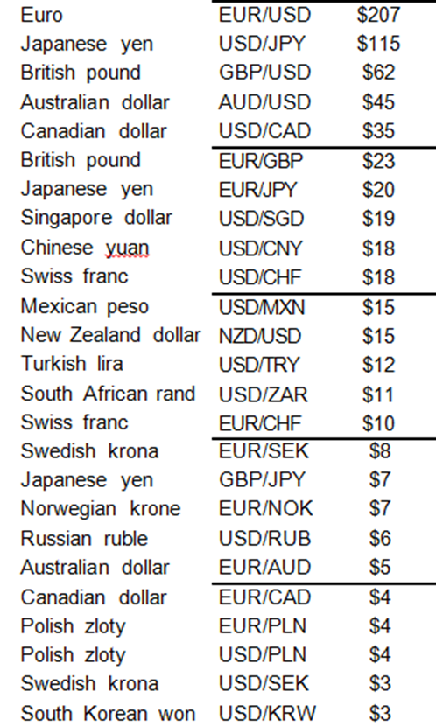
Most Traded Spot FX Pairs in London – Oct 2019 ($ Billions)

Slide 12
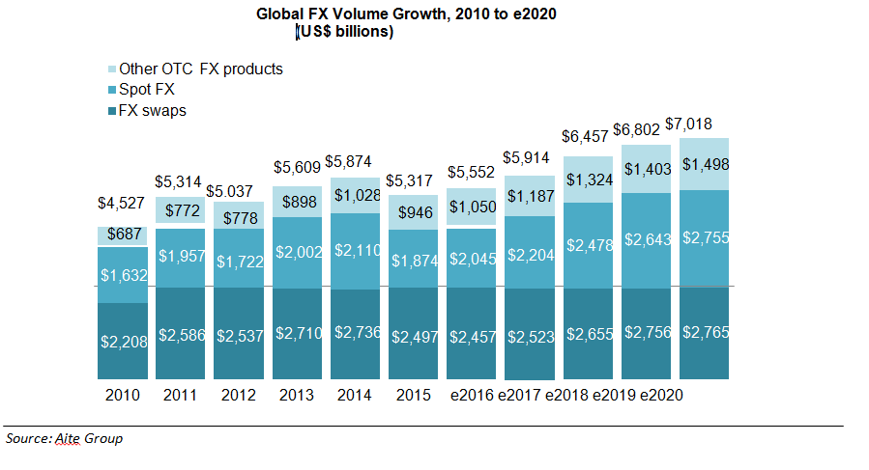
Trading Volume Outlook by FX Product

Slide 13
Spot Quotation Method
Direct - USD is the base currency
If USD/JPY is 105.50/60
That’s 105.50 Yen for one Dollar
Indirect – USD is the Quoted Currency
If EUR/USD IS 1.2590/95
1 Euro buys 1.2590 Dollars
Here Euro is the base currency
USD is the base currency except for
EUR
GBP
AUD & NZD
Small countries that used to use Sterling e.g. Fiji, Tonga

Slide 14
Why Are Exchange Rates Important? (1 of 2)
25) The US Dollar is the base currency for FX currency pair quotation purposes except for
A) CAN $, AUD, NZD
B) EUR, GBP, AUD, NZD
C) EUR, CAN $, AUD, NZD
D) EUR, GBP, CAN $
Answer: B
Benefits domestic consumers (you)

Slide 15
I am buying or I am selling the base currency?
If I am a client e.g. Fund Manager and I ring JP Morgan up and Sell JPM EUR 1 Million
I have sold EUR1MM
JPM has bought EUR1MM

Slide 16
Which Side of the Price? EUR/USD is 1.2590/95 BID 1.2590 Offer 1.2595
BID OFFER
Market Taker Sells Base Buys Base
e.g. Client / Fund Manager
Market Maker Buys Base Sells Base
e.g Investment Bank
Market Taker Says: “YOURS” “MINE”
“Yours” and “Mine” refer to the BASE Currency
i.e. “The Euros are “Mine”
1.2590
1.2595

Slide 17
Which Side of the Price? A Garage Dealer is making a market in a specific Toyota Yaris car 1.2500 – 1.5000 (in units of £1000 i.e. £1,250 - £1,500)
1. You the client “What price can I sell you the market maker/garage a Toyota car?” Answer: £1,250 ( 1.25 x1000)
2. You the client “What price can I buy from you a Toyota car?” Answer: £1,500 ( 1.50 x1000)
Garage £1,250 - £1,500
Garage BID £1,250 - OFFER £1,500
The Investment Bank is effectively the FX Garage!

Slide 18
Which Side of the Price?
1. You the client (in financial terms e.g. the fund manager) sell base currency on the Bid – the left hand side of the quote –the maket-maker/investment bank buys
Garage… £1,250 - £1,500
Bank…… EUR/USD 1.10 - 1.12
2.You the client (in financial terms e.g. the fund manager) buy base currency on the offer/ask – the right hand side of the quote – the maket-maker/investment bank sells

Slide 19
Question
JP Morgan Investment Bank are quoting the following GBP/USD rates.
GBP/USD 1.2990 BID - 1.3010 OFFER
You the client /Fund Manager want to sell GBP10 MM
What price will you trade at ?
Think if you were selling a Toyota Yaris? £1.2500 - £1.5000
A) 1.2990
B) 1.3010
Benefits domestic consumers (you)
Answer A

Slide 20
Your turn to trade!
4) Investment Banks are quoting the following GBP/USD rates.
Bank A GBP/USD 1.2990 BID - 1.3020 OFFER
Bank B GBP/USD 1.3010 BID - 1.3030 OFFER
Bank C GBP/USD 1.2995 BID - 1.3025 OFFER
You, the Client, wish to BUY GBP SELL USD.
What is the best price you, the client to the bank, can deal at?
A) 1.2995
B) 1.3020
C) 1.3025
D) 1.2990
Benefits domestic consumers (you)
Answer B

Slide 21
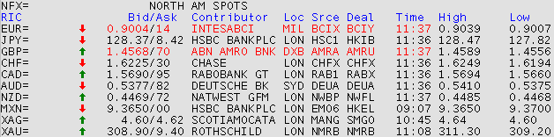
Primarily OTC Contributed by Banks and Brokers

Slide 22
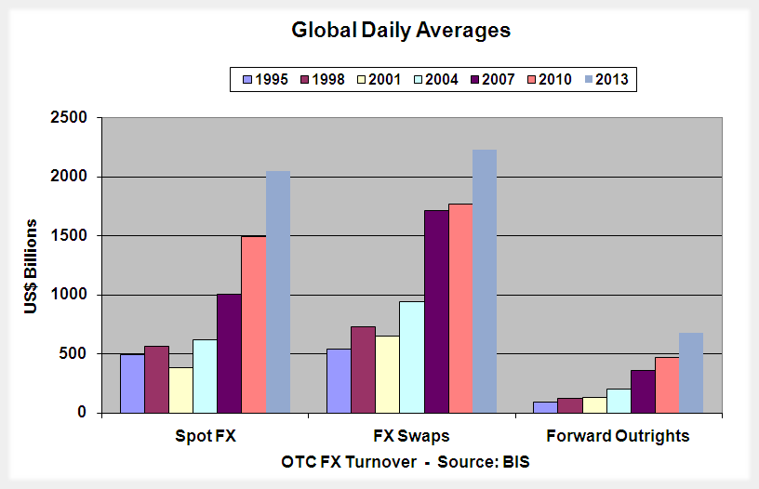
BIS Triennial Survey, April 2013 – ADV 5.53 Trillion US$

Slide 23
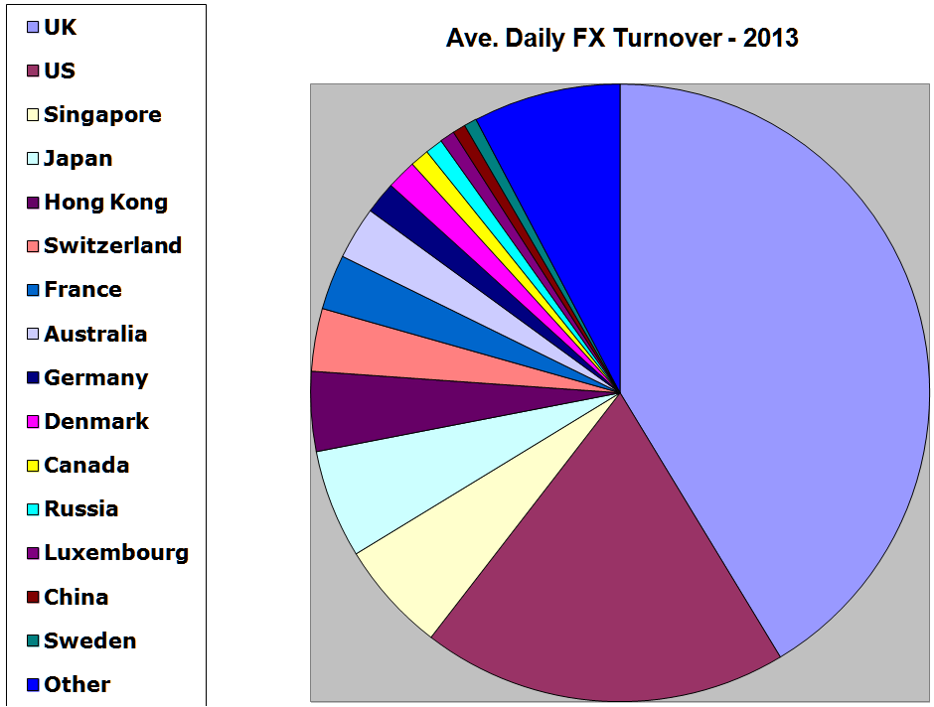
FX in 2018: US$ 5.53 Trillion per day (Where it’s dealt)
CN
SE
LU
OTHER
RU
CA
DK
DE
AU
FR
CH
UK
HK
JP
SG
US
Source: BIS

Slide 24
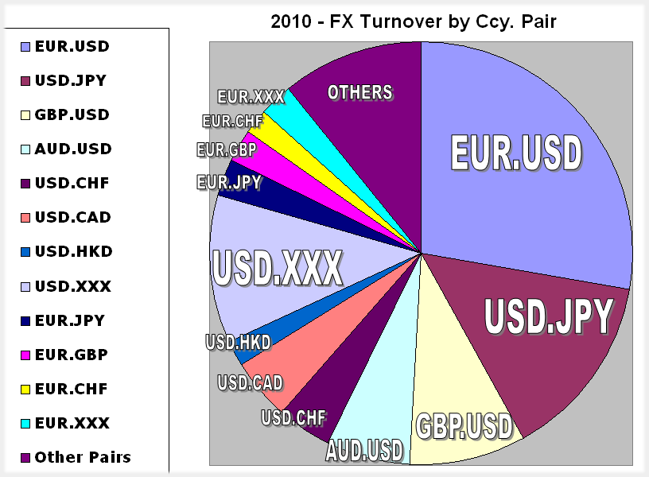
Average Turnover by Currency Pair
Source: BIS

Slide 25
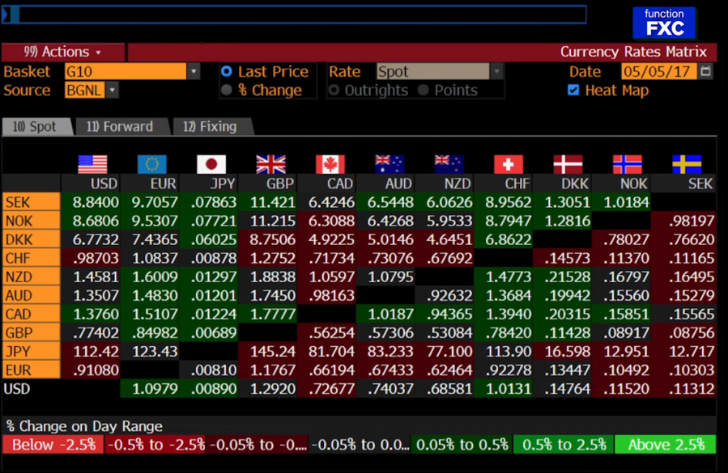
Major Cross Rates
What if I don’t want to sell USD/JPY or USD/Can $ buy Can$/JPY = Cross Rate

Slide 26
AcF 304 Financial Markets Topic 5 – The Foreign Exchange Market
Part 5 – FX Forwards & FX Swaps
Notes:
If this PowerPoint presentation contains mathematical equations, you may need to check that your computer has the following installed:
1) MathType Plugin
2) Math Player (free versions available)
3) NVDA Reader (free versions available)

